Slide 1
Single-Molecule Detection Based on Nitrogen Vaccancy center
Group Two
李铎 程阳 潘志明 刘彦昭 吴天伟 刘百银 陈澄 马赫
2016.11.08

Slide 2
Outline
Brief Introduction&Background
Applications
Summary
Challenges

Slide 3



Slide 4
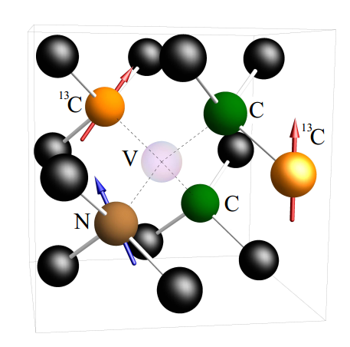
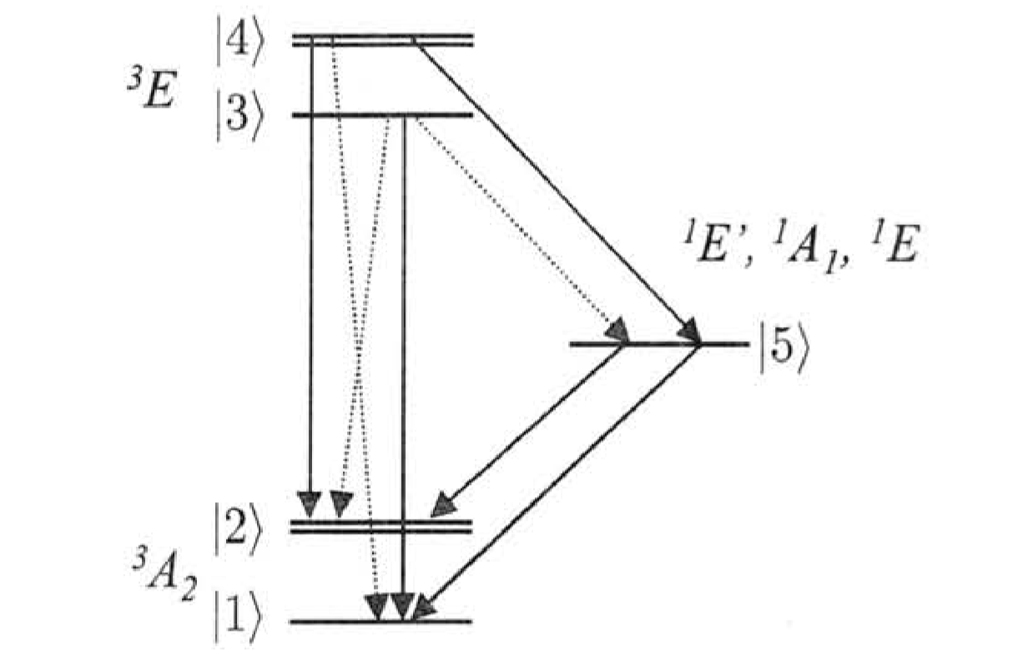
ESR(电子自旋共振谱)/ODMR（光检测磁共振）
基态&激发态：自旋三重态

Slide 5
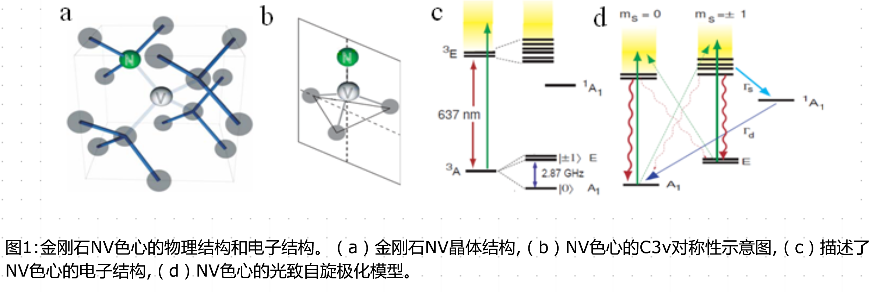
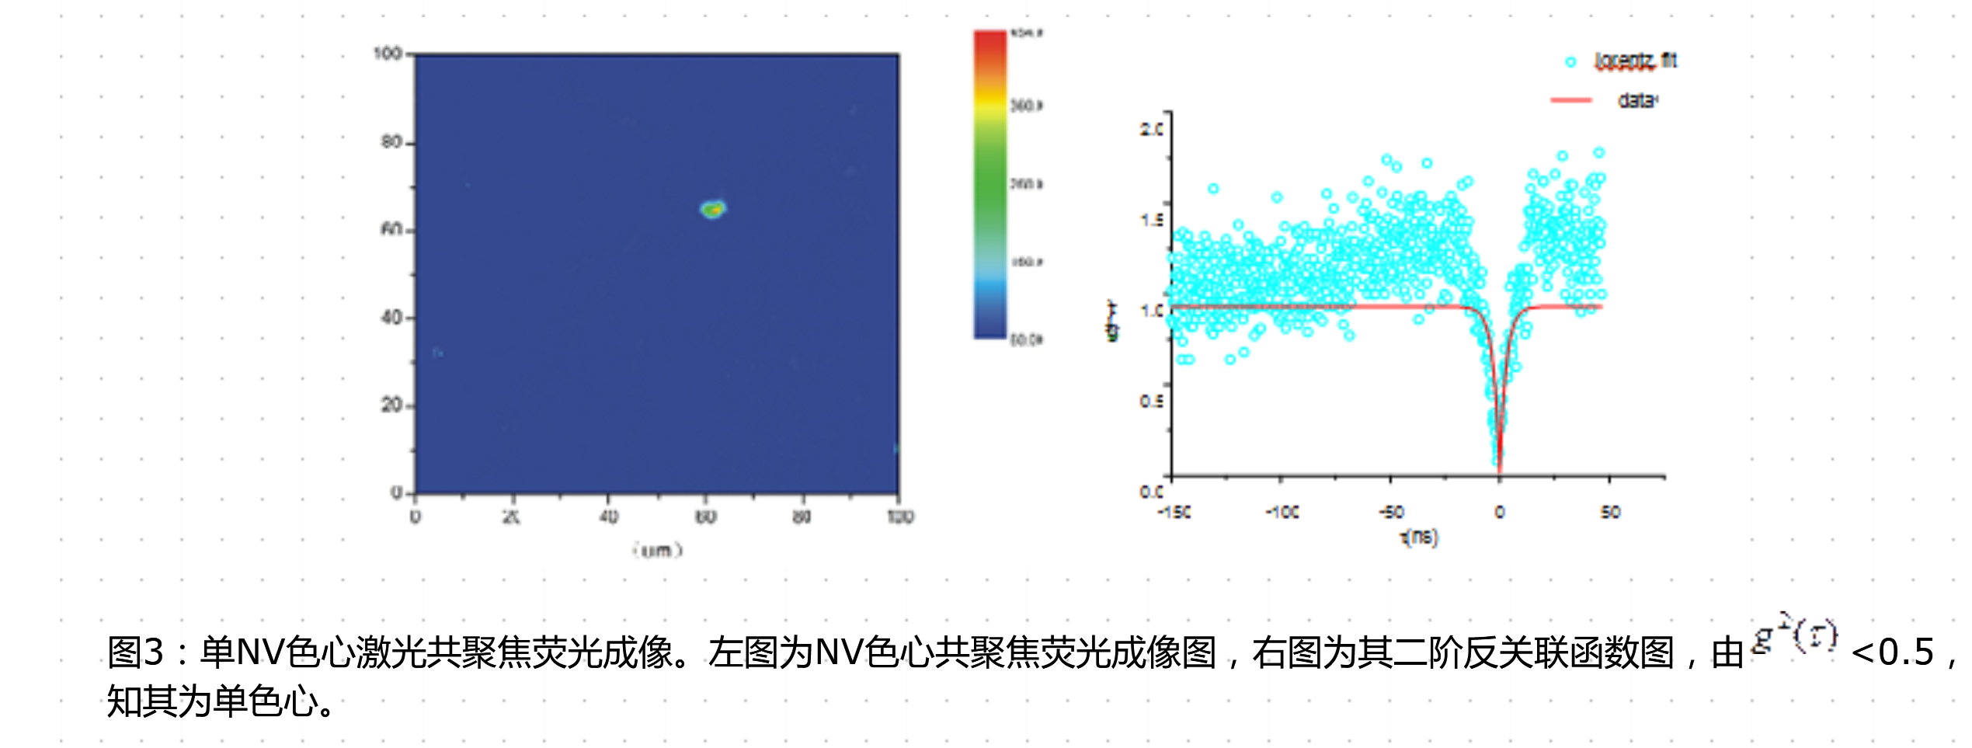

Slide 6
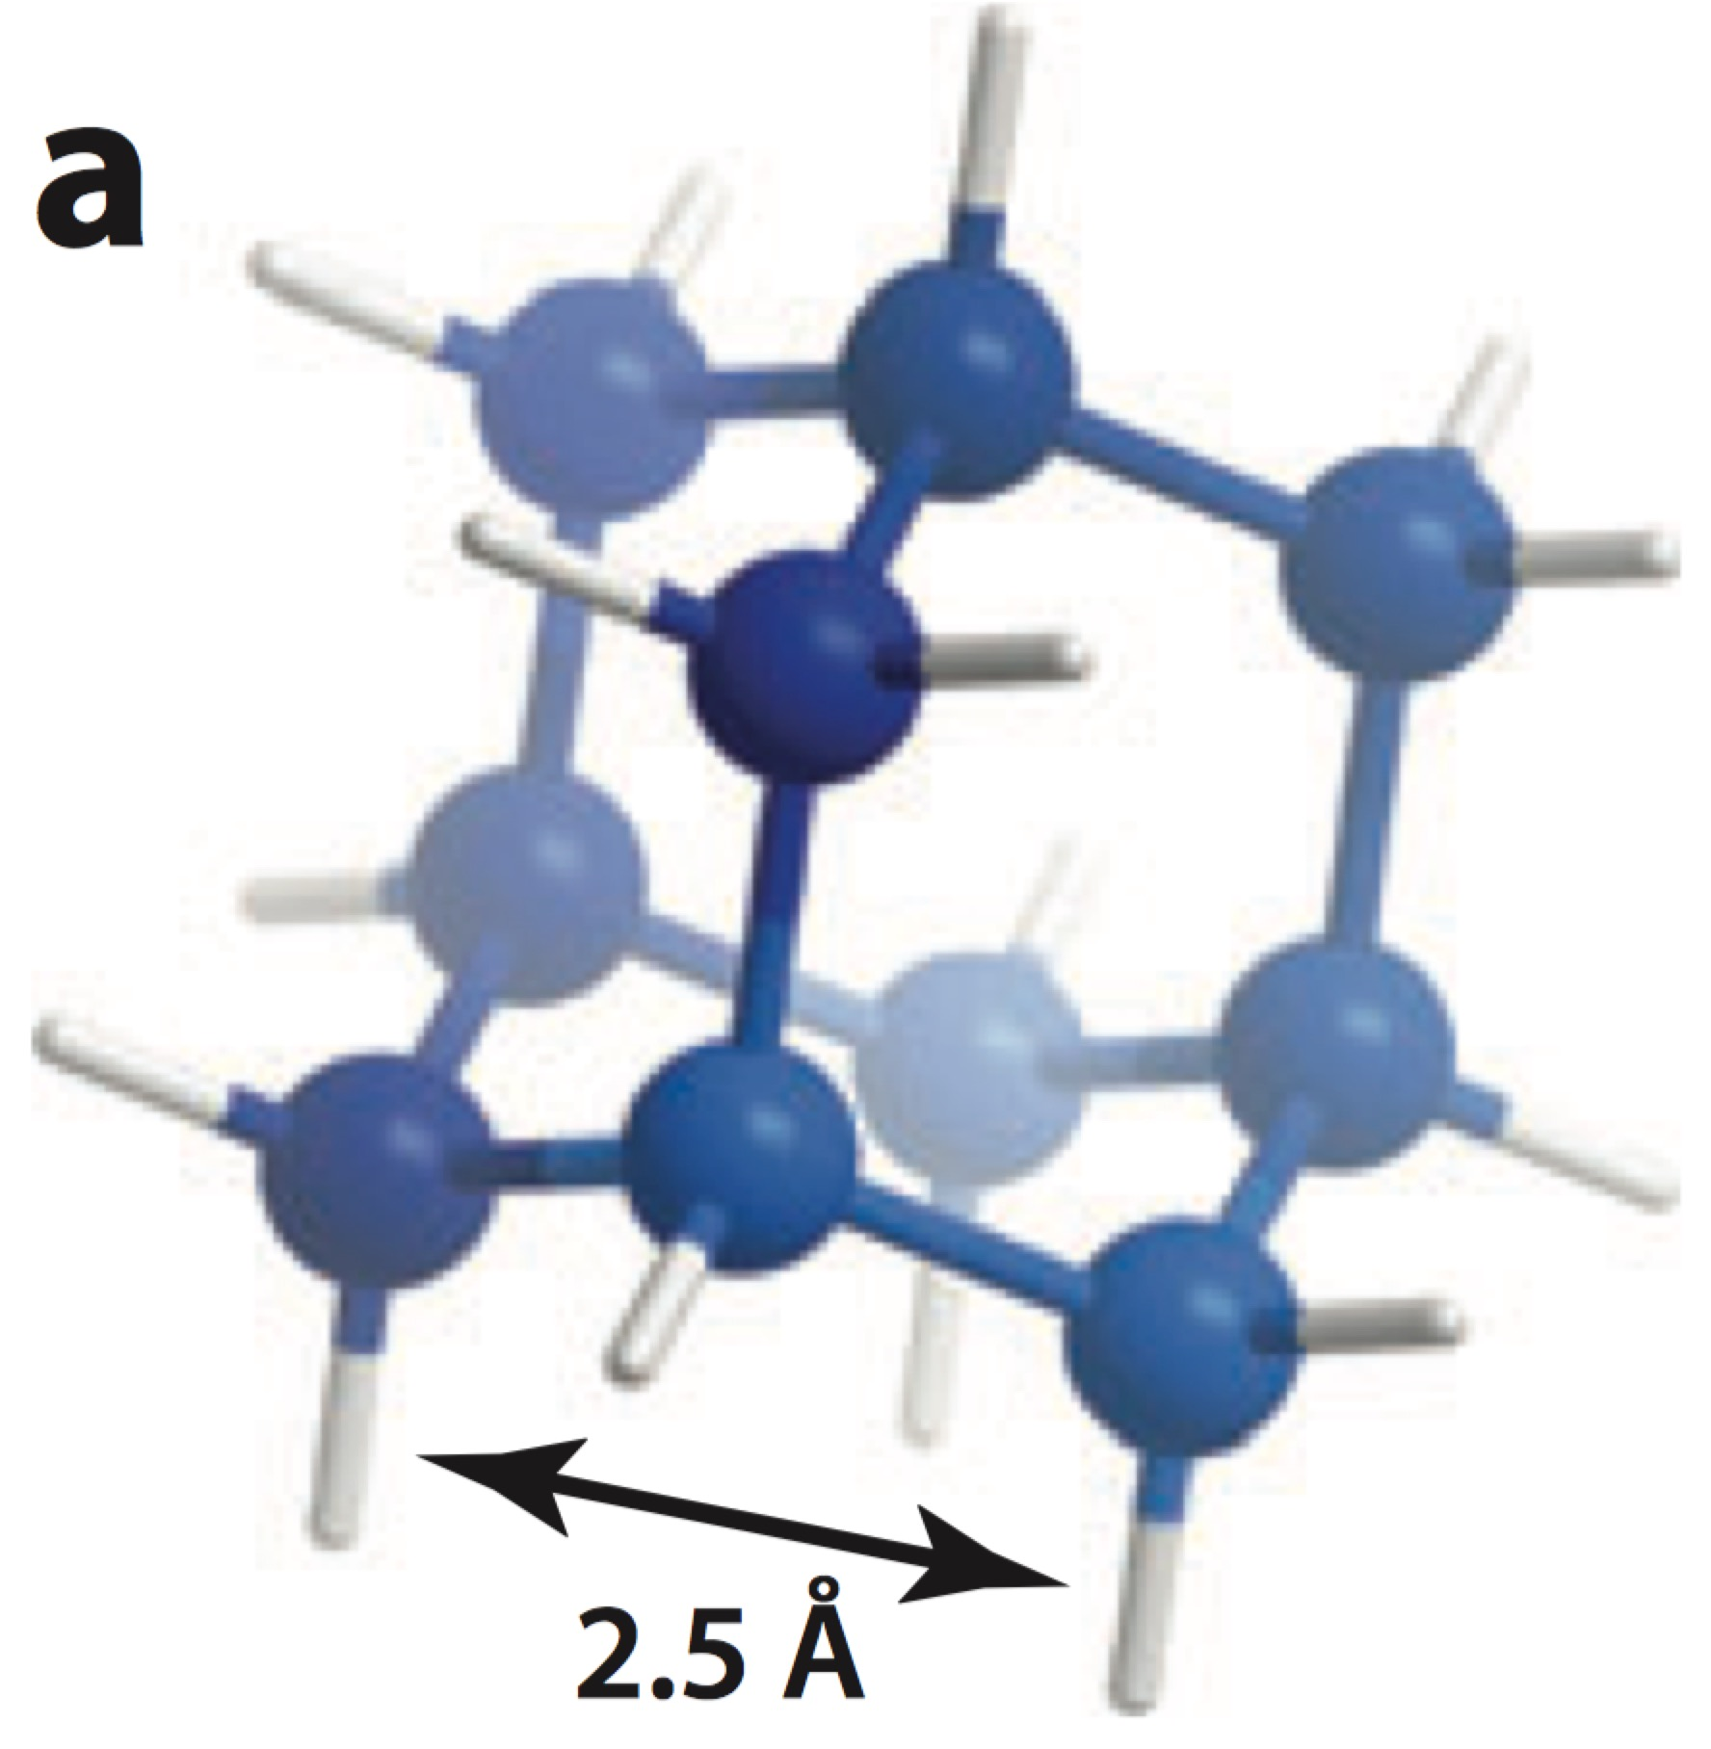
Nano
Diamond
NV center
Nanodiamond
NV center
Adamantane
Detonation nanodiamonds
Diamond nanoparticles
Millimeter-sized single crystal diamond
1 http://adamasnano.com, accessed June 25, 2013
2 Havlik J,et al. Nanoscale 5:3208–11,2013
3 Wort CJ, Balmer RS. Mater. Today 11:22–28,2008

Slide 7
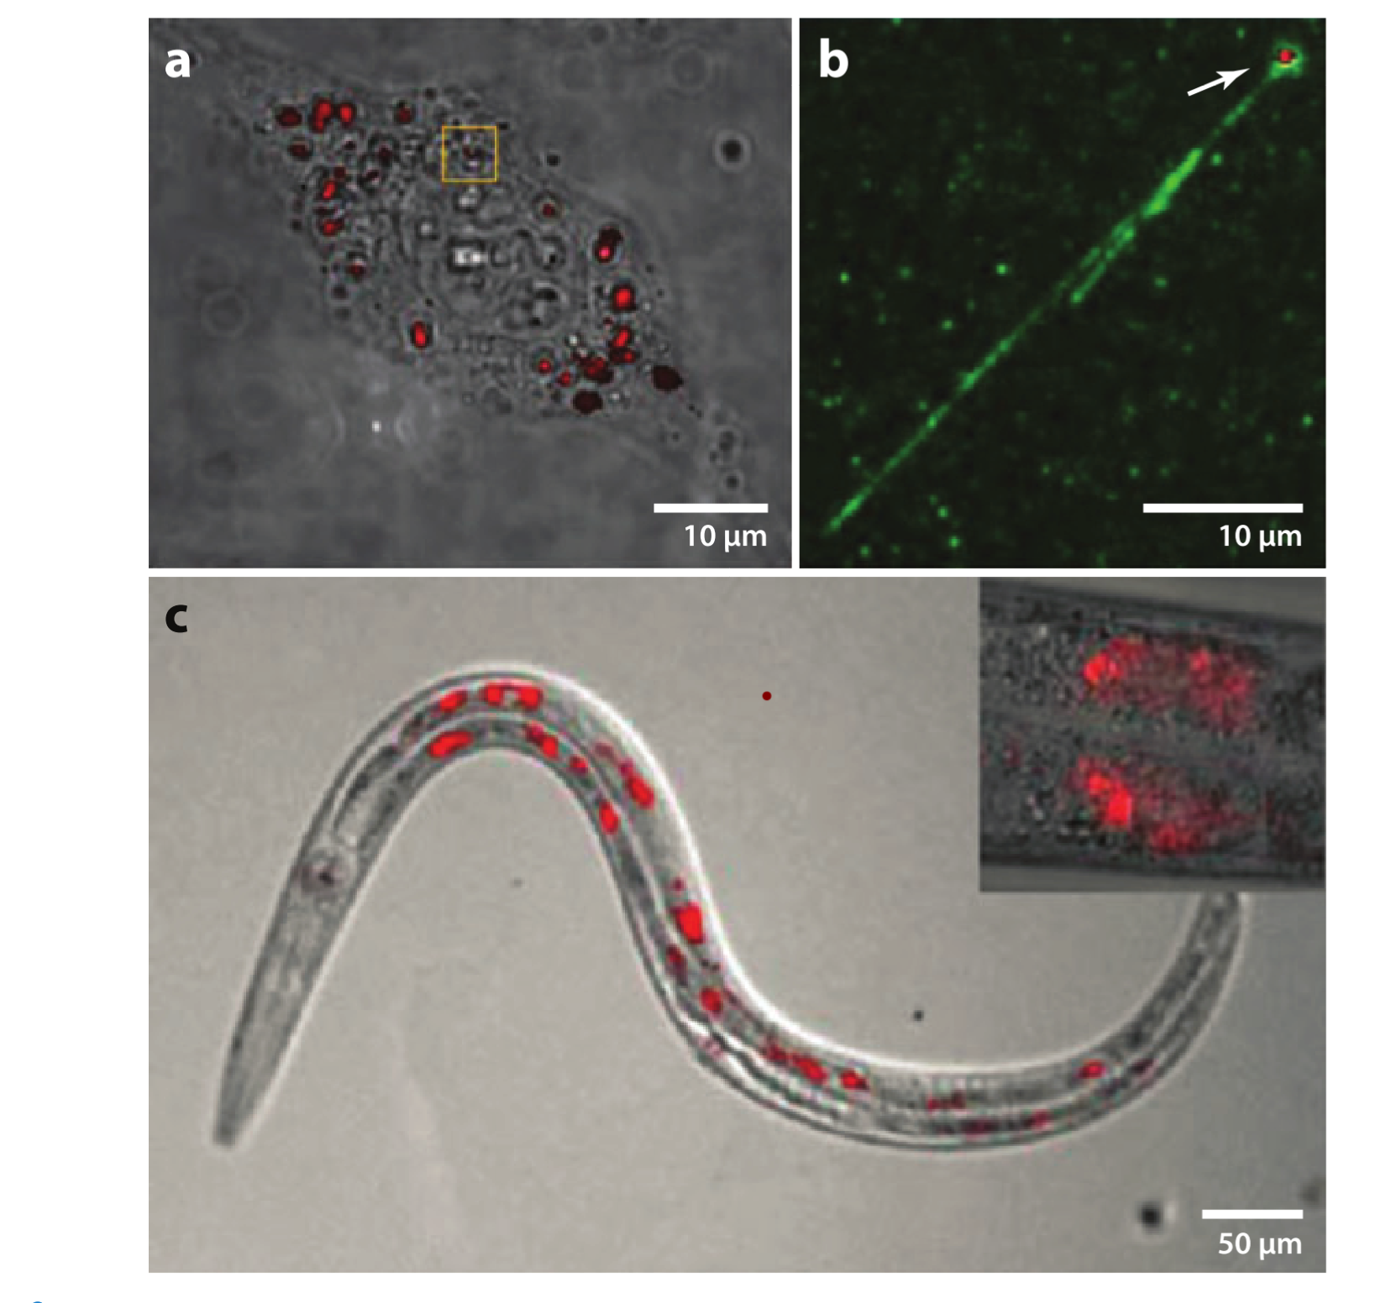
Hela Cell
DNA
新杆状线虫
1. Fu CC ,et al. Proc. Natl. Acad. Sci. USA 104:727–32
2.McGuinness LP ,et al. Nat. Nanotechnol. 6:358–63

Slide 8
How NV centers can be harnessed for nanoscale sensing
The NV center is very sensitive to magnetic ﬁelds
Sensing Protocols:
The three most common approaches are :
1.the direct detection of the EPR（电子顺磁共振谱） spectrum using continuous-wave spectroscopy
2.the measurement of the time evolution in (pulsed) pump-probe experiments
3.measurements of spin relaxation times.

Slide 9
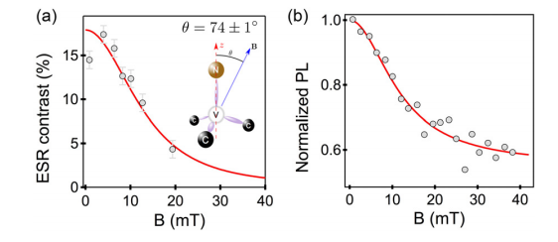
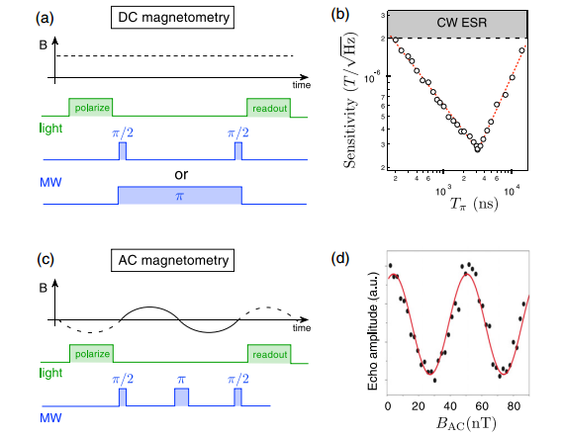
Principles of NV magnetometry
ESR contrast and
normalized PL intensity as a function of magnetic field amplitude applied with an angleθ=74◦ with respect to the NV defect axis. The solid line is the result of a rate equation model developed in reference
Rondin, L. Tetienne, J. P., Hingant, T. et al.Magnetometry with nitrogen-vacancy defects in diamond. Rep. Prog. Phys.(2014) 77,056503.

Slide 10
Brief Introduction&Background
Applications
Summary
Challenges

Slide 11
The applications of the NV− centre each utilise one or a combination of the following five key properties of the centre:
A bright photostable optical transition that is sitable for the detection of individual centres and single photon generation
An optical ZPL fine structure that is dependent on electric, magnetic and strain fields at low temperature, but is approximately electric and strain field independent at room temperature
A magnetically resonant and controllable ground state electronic spin that exhibits long coherence times and coupling to proximal electronic and nuclear spins
Optical spin-polarisation and readout of the ground state spin
Flexibility and robustness in fabrication

Slide 12
Applicaiton
Fluorescence
Biology
Single photon source
Magnetic porperties
Magnetometry
Nuclear Magnetic Resonance
Magentic Resonaced Imaging
BIology
What Can We Do?

Slide 13
Monitoring of ion concentration by relaxometry measurements of nanodiamonds in solution
Microfluidic channel integrating an NV sensor array
Optical trapping and maneuvering of nanodiamonds through living cells.
Sensing of cell potentials by membrane-embedded nanodiamonds
Nanoscale thermometry.
Strain sensing in mechanical diamond membranes.
@Toyli DM, et al. Nano Lett. 10:3168–72,2010
@Steinert S, et al. Nat. Commun. 4:1607,2013

Slide 14
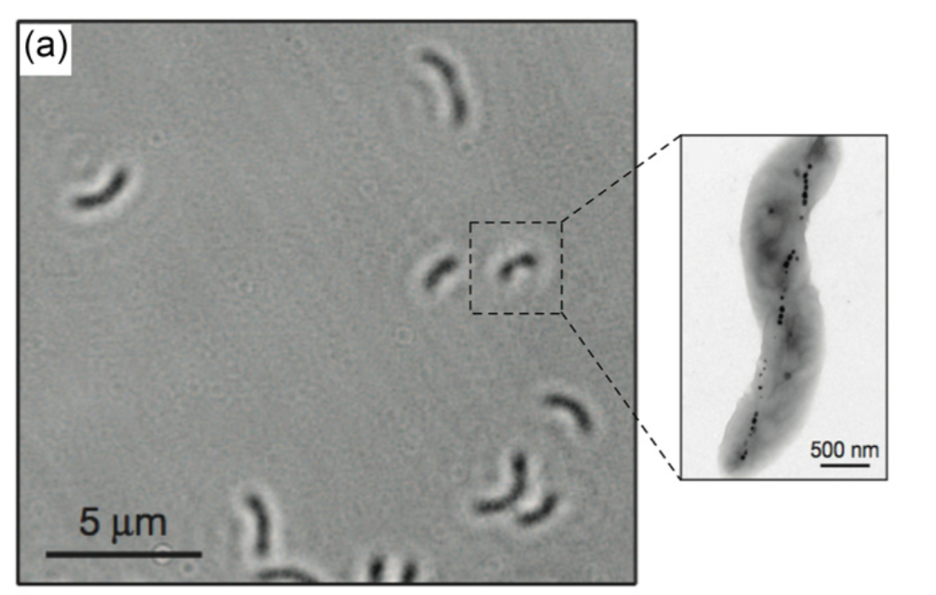
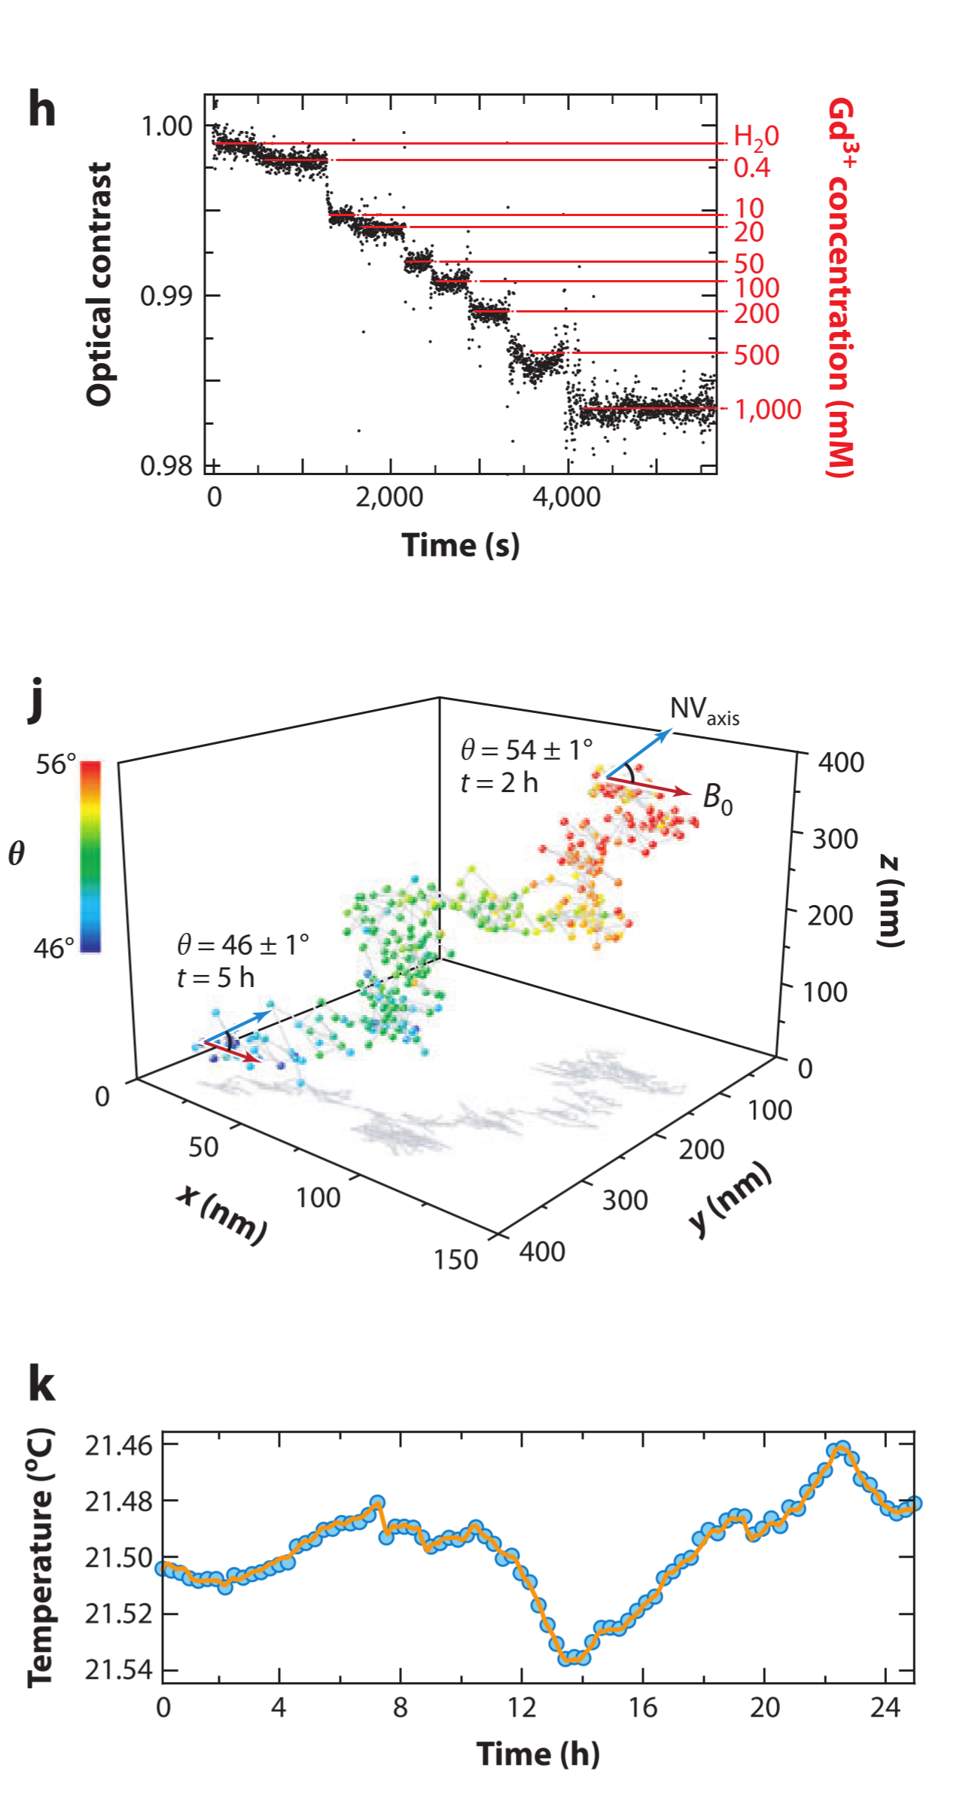
g. Diamond sensor array created by ion implantation of bulk diamond crystal. Each pixel contains from a single up to a few NV centers
h. Concentration measurements of Gd3+(钆3) ions based on relaxometry.
i.MTB:magnetotatic bacteria
j. Orientation and position tracking of a single nanodiamond over several hours. Panel j reprinted with permission from Reference 37.
k. Monitoring of laboratory temperature over 24 h using a bulk diamond sensor.
@Le Sage D,et al. Nature 496:486–89,2013
@McGuinness LP,et al. Nat. Nanotechnol. 6:358–63,2011
@Neumann P, et al. Nano Lett. 13:2738–42,2013

Slide 15
Applications in scanning probe microscopy
Examples of scanning magnetometry. (a) Magnetic image of a vortex core in a thin ferromagnetic ﬁlm. (b) Magnetic image of the electron spin of a second, immobile NV center from 50 nm away. (c) Isoﬁeld surface of a magnetic nanotip showing a spatial resolution of <10 nm
Basic principle of scanning magnetometry. A sharp tip with a nitrogen vacancy center at the apex is used to map out the three-dimensional magnetic ﬁeld vector above a magnetic nanostructure, such as an isolated electronic spin.
Rondin L, Tetienne JP, Rohart S, Thiaville A, Hingant T, et al. Nat. Commun. 4:2279,2013

Slide 16
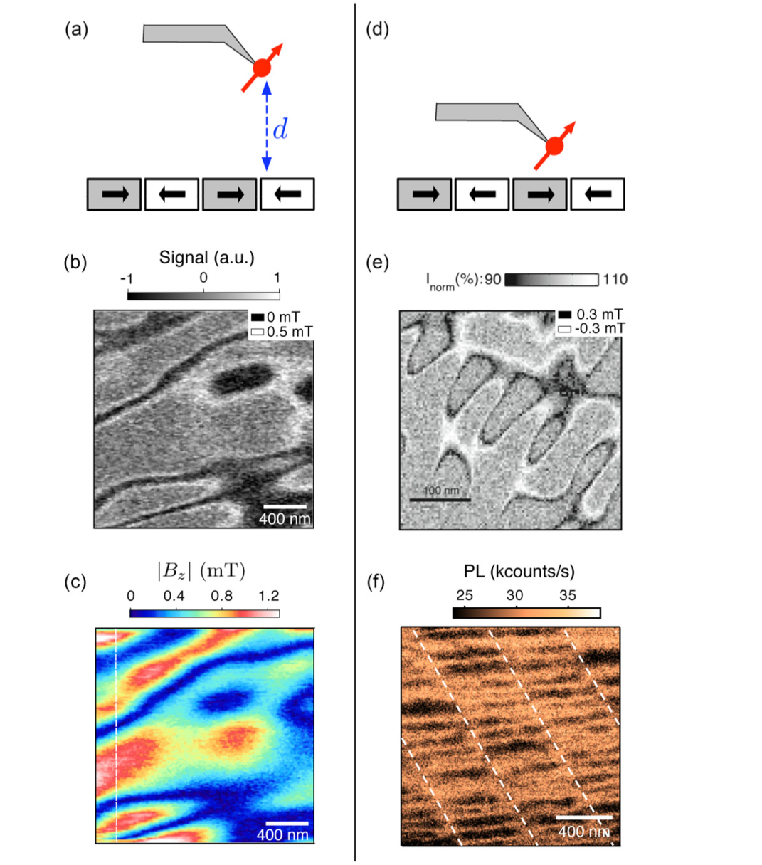
Dc magnetic field imaging methods
ESR(电子自旋共振谱) spectrum can be recorded at each pixel of the scan.
The full magnetic field
Rondin L et al Appl. Phys. Lett. 100 153118,2012
Maletinsky P et al Nature Nanotechnol. 7 320,2012

Slide 17
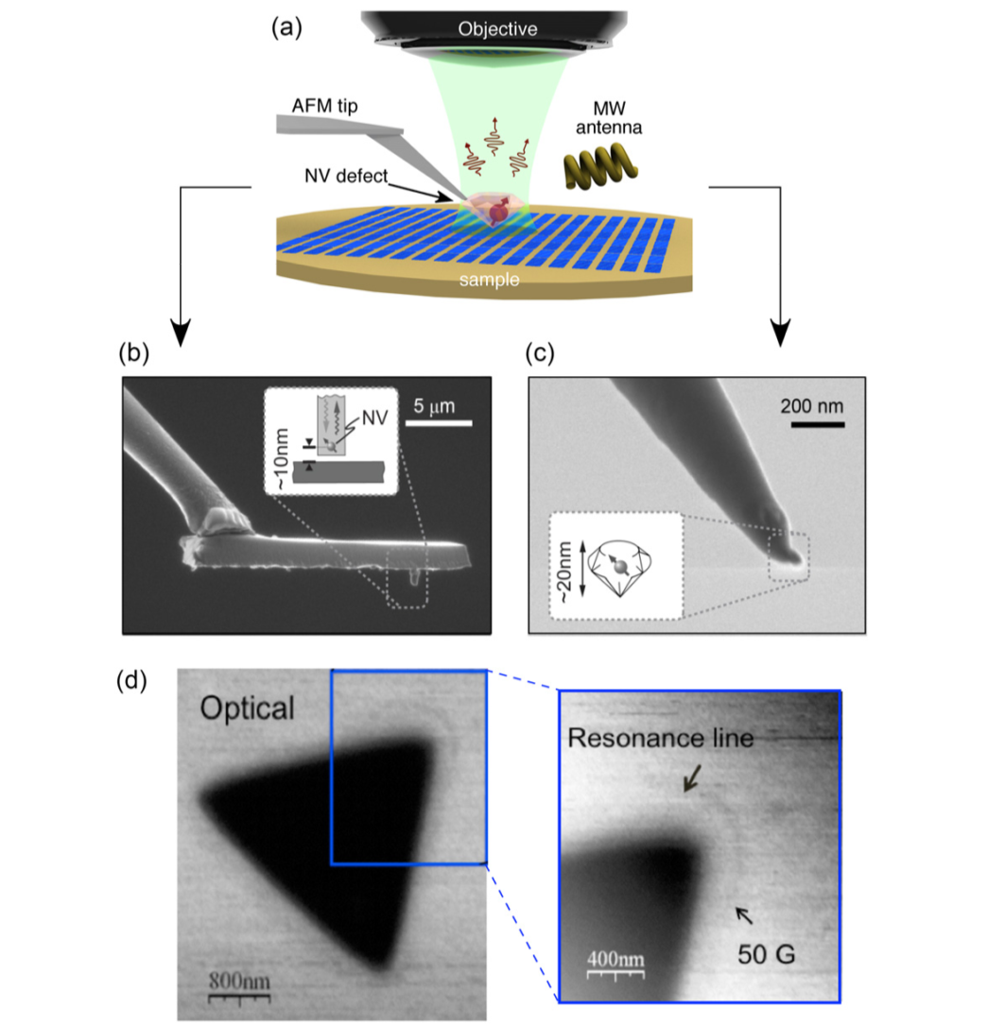
NV Center + AFM
Rondin, L. Tetienne, J. P., Hingant, T. et al.Magnetometry with nitrogen-vacancy defects in diamond. Rep. Prog. Phys.(2014) 77,056503.

Slide 18
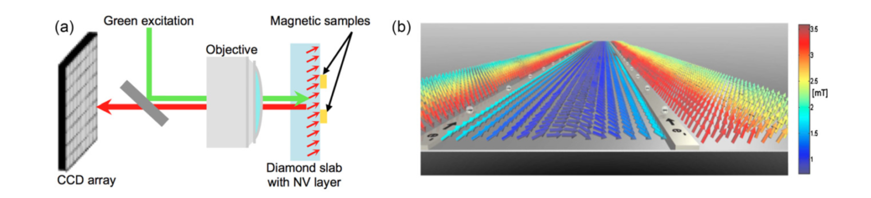
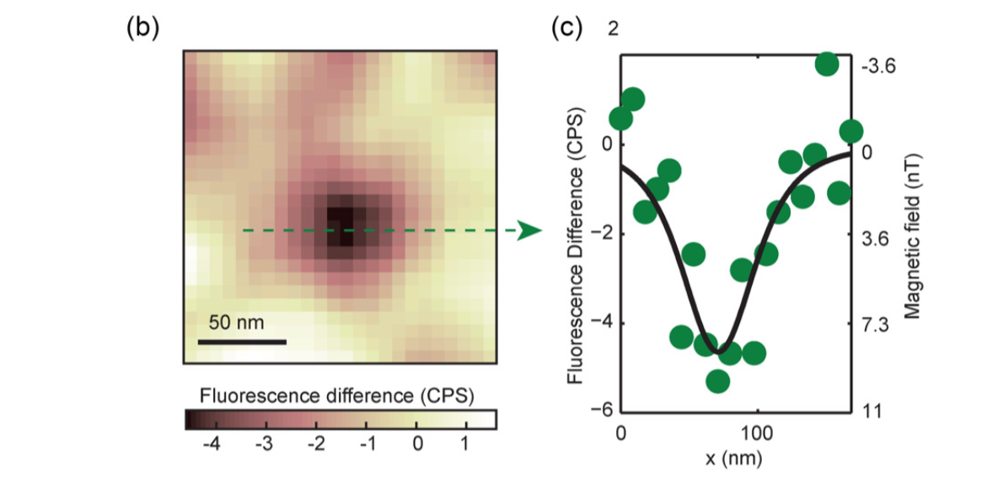
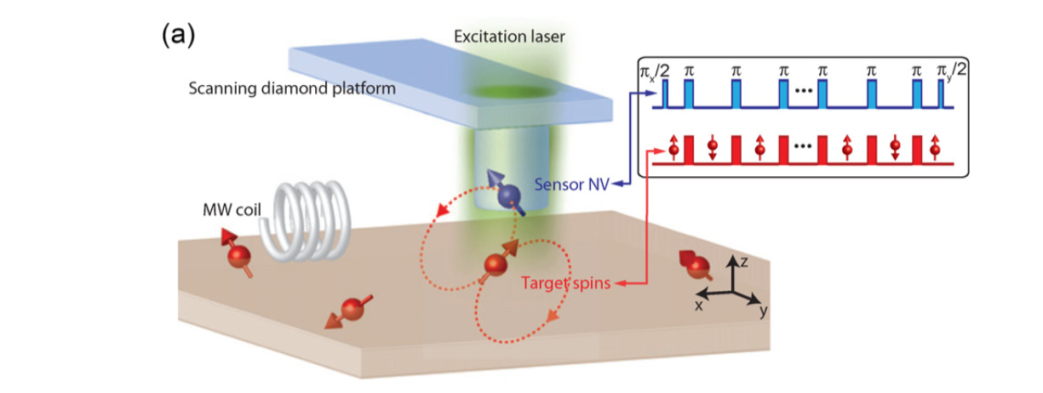
Rondin, L. Tetienne, J. P., Hingant, T. et al.Magnetometry with nitrogen-vacancy defects in diamond. Rep. Prog. Phys.(2014) 77,056503.
Single electron spin detection

Slide 19
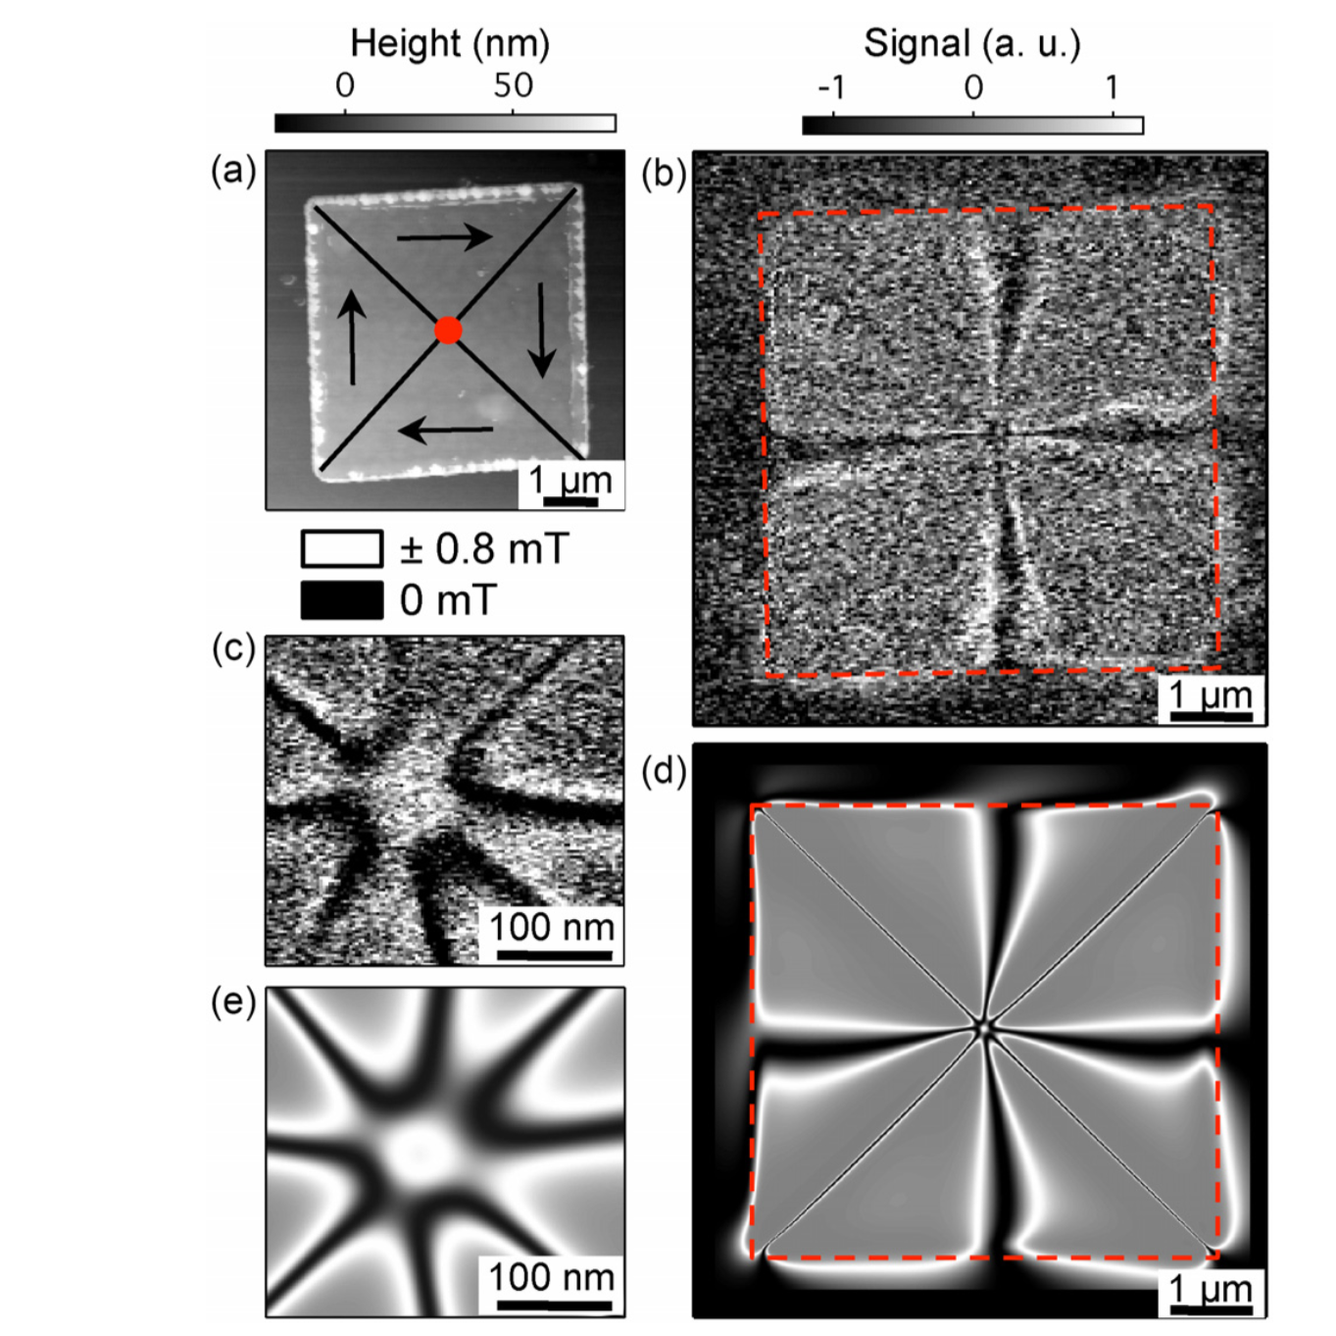
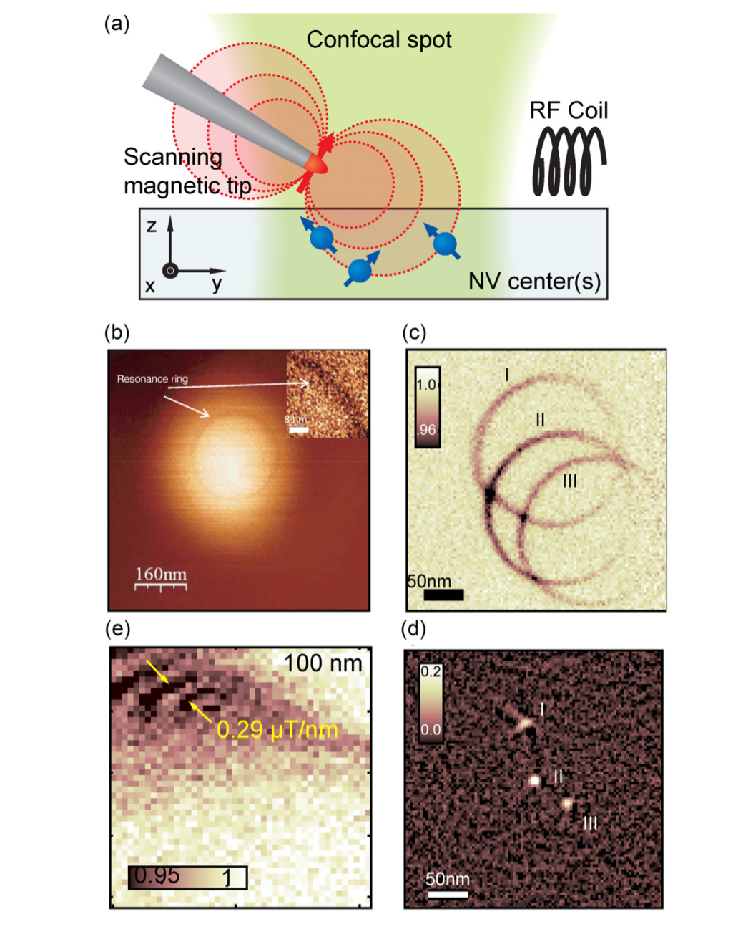
First experimental demonstration of magnetic gradient imaging .
Magnetic Vortex Core
AFM+MFM (Magnetic Force Microscope) Permalloy(坡莫合金)
Rondin, L. Tetienne, J. P., Hingant, T. et al.Magnetometry with nitrogen-vacancy defects in diamond. Rep. Prog. Phys.(2014) 77,056503.
Rondin, L. Tetienne, J. P., Hingant, T. et al.Magnetometry with nitrogen-vacancy defects in diamond. Rep. Prog. Phys.(2014) 77,056503.
Rondin L et Nature Commun. 4 2279，2013

Slide 20
Applications in nanoscale NMR/MRI spectroscopy
(a) Geometry of the experiment. A single NV defect implanted near the diamond surface is used to detect proton spins within liquid and solid organic samples placed on the crystal surface. (b) NMR spectrum of statistically polarized nuclei in the vicinity of the shallow implanted NV centre, including a strong contribution of 13C nuclei inside the diamond matrix and a weaker component of 1H nuclei on the diamond surface.
@Staudacher T et al ，Science ，339 561，2013

Slide 21
Brief Introduction&Background
Experimental methods and demonstrations
Applications
Summary
Challenges

Slide 22
Diamond color centers are fluorescent impurities in diamond.
The NV center is a color center consisting of a substitutional nitrogen and a lattice vacancy. The luminescence of the NV center is extremely robust, with no bleaching or blinking under normal conditions.
NV centers can be embedded in nanocrystals down to 4–5 nm in size. Diamond nanocrystals are chemically very robust, nontoxic, and easily functionalized for biological targeting.
The unique features ofthe NVcenter are its magnetic (spin triplet) ground state and the dependence of its fluorescence intensity on the spin orientation. This feature is utilized to add (magnetic) sensing capabilities.
EPR spectra of single NV centers can be detected by measuring the fluorescence intensity in response to microwave irradiation (ODMR technique).
Sensing is performed by monitoring shifts of the EPR spectra due to external perturbations. Perturbations can be generated by many means, including magnetic and electric fields, temperature, spatial orientation, strain, pressure, and other physical parameters.
NV centers can be embedded in nanocrystals, sensor arrays, and scanning probe heads,
giving rise to an extraordinary variety of possible applications.

Slide 23
Brief Introduction&Background
Applications
Summary
Challenges

Slide 24
Surface Effects
1、For very shallow NV centers, loss of charge may also occur via quantum mechanical tunneling. In the case of band bending, the location of the Fermi level with respect to the NV − excited state determines the charge stability of the defect.
Ways to solve this problem:
Surface termination by oxygen or ﬂuorine;
2、NV centers near surfaces also experience enhanced magnetic noise that manifests itself in reduced spin relaxation times compared to bulk diamond.

Slide 25

2016年11月8日

